Slide 1
Partial View
Partial view is special view which renders a portion of view content.
It is just like a user control web form application
reusable in multiple views(helps to reduce code duplication)
The partial view is instantiated with its own copy of a ViewDataDictionary object which is available with the parent view so that partial view can access the data of the parent view
To create a partial view, right-click on view -> shared folder and select Add -> View option. In this way we can add a partial view.

Slide 2
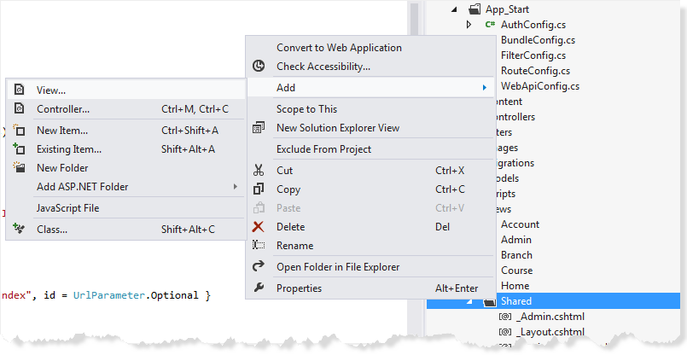
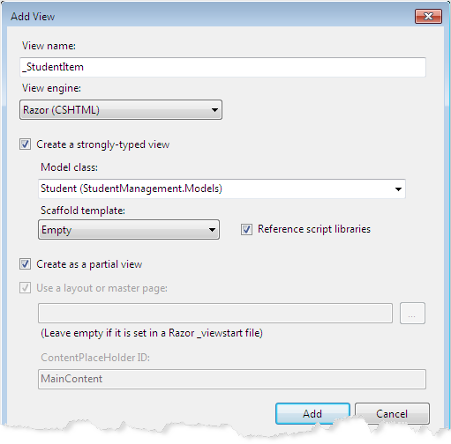
Partial View

Slide 3
Methods To Access the Partial view
Html.RenderPartial
This method result will be directly written to the HTTP response stream means it used the same TextWriter object as used in the current webpage/template.
This method returns void.
Simple to use and no need to create any action.
RenderPartial method is useful when the displaying data in the partial view is already in the corresponding view model.For example : In a blog to show comments of an article, we would like to use RenderPartial method since an article information with comments are already populated in the view model.
@{Html.RenderPartial("_Comments");}
This method is faster than Partial method since its result is directly written to the response stream which makes it fast.

Slide 4
Methods To Access the Partial view
Html.Partial
Renders the partial view as an HTML-encoded string.
This method result can be stored in a variable, since it returns string type value.
Simple to use and no need to create any action.
Like RenderPartial method, Partial method is also useful when the displaying data in the partial view is already in the corresponding view model. For example: In a blog to show comments of an article, you can use Partial method since an article information with comments are already populated in the view model.
@Html.Partial("_Comments")

Slide 5
Methods To Access the Partial view
Html.RenderAction
This method result will be directly written to the HTTP response stream means it used the same TextWriter object as used in the current webpage/template.
For this method, we need to create a child action for the rendering the partial view.
RenderAction method is useful when the displaying data in the partial view is independent from corresponding view model.For example : In a blog to show category list on each and every page, we would like to use RenderAction method since the list of category is populated by the different model.
@{Html.RenderAction("Category","Home");}
This method is the best choice when you want to cache a partial view.
This method is faster than Action method since its result is directly written to the HTTP response stream which makes it fast.

Slide 6
Methods To Access the Partial view
Html.Action
Renders the partial view as an HtmlString .
For this method, we need to create a child action for the rendering the partial view.
This method result can be stored in a variable, since it returns string type value.
Action method is useful when the displaying data in the partial view is independent from corresponding view model.For example : In a blog to show category list on each and every page, we would like to use Action method since the list of category is populated by the different model.
@{Html.Action("Category","Home");}
This method is also the best choice when you want to cache a partial view.

Slide 7
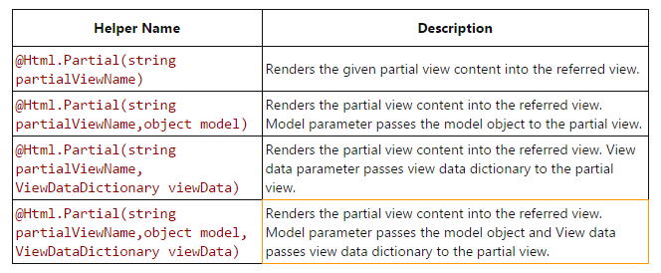
Methods To Access the Partial view -Html.Partial

Slide 8
Call the partial view
Html.RenderPartial(”Path of the partial view", model);
@Html.Partial(“Path of the partial view ", model);
<script type="text/jscript">
$('#partialView').load('/shared/PartialViewExample’);
</script>

Slide 9
Difference between
Html.Partial & Html.RenderPartial
Partial | RenderPartial
returns a string | returns void and Write internally
Store the output in to a variable | Can’t do this (result will be written to the Response stream during execution)
Slower Method | Faster Method (giving quick response)

